Slide 1

TOPIC - ENERGY ANALYTICS USING NAIVE-BAYES
INT315 - CLUSTER COMPUTING
BY - BAIBHAB MUND
REDG NO - 12213120
ROLL NO - 58 GUIDED BY:
SECTION – K22ZC ZEENAT ZAHARA MA’AM

Slide 2
Project Description:
This project applies Naive Bayes techniques to analyze and enhance decision-making in the field of energy analytics.
focuses on understanding energy consumption behavior, identifying trends, and building a data-driven predictive model using a real-world dataset.
Dataset - World Energy Consumption (Source - Kaggle)

Slide 3
Objectives:
Acquire and clean the energy dataset, removing nulls and inconsistencies.
Conduct exploratory data analysis to identify key trends.
Build a Naive Bayes model to classify high and low energy consumption patterns.
Visualize and interpret the results effectively (Dashboard Creation).

Slide 4
Libraries:
from pyspark.sql import SparkSession
from pyspark.sql.functions import col, when, median
from pyspark.sql.types import DoubleType
from pyspark.ml.feature import VectorAssembler
from pyspark.ml.classification import NaiveBayes
from pyspark.ml import Pipeline
from pyspark.ml.tuning import ParamGridBuilder, CrossValidator
from pyspark.ml.evaluation import MulticlassClassificationEvaluator

Slide 5
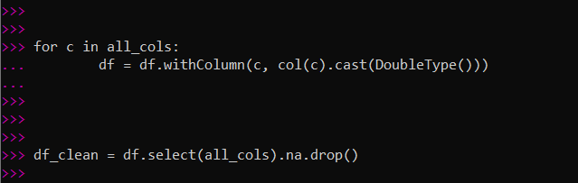
Methodology:
df = spark.read.csv("D:\Academics\Cluster Project\World Energy Consumption.csv", header=True, inferSchema=True)
for c in all_cols:
df = df.withColumn(c, col(c).cast(DoubleType()))
df_clean = df.select(all_cols).na.drop()
1. Data Preparation / Cleaning:
○ Loaded dataset using PySpark
○ Converted numeric fields to DoubleType.
○ Removed null or inconsistent entries.

Slide 6
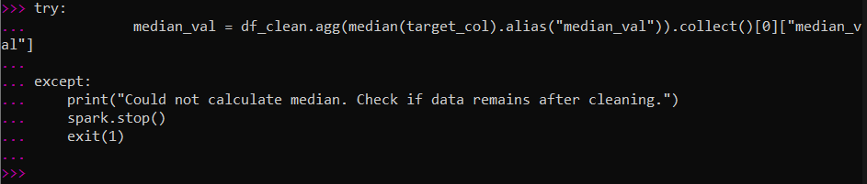
median_val = df_clean.agg(median(target_col).alias("median_val")).collect()[0]["median_val"]
df_model = df_clean.withColumn(
"lable”,
when(col(target_col) >= median_val, 1.0).otherwise(0.0)
)
2. Feature Engineering:
○ Created a binary classification label — High (≥ median) and Low (< median) energy per capita.
(Eg: target_col = energy_per_capita)

Slide 7
Target Column (Label Column):
Energy_per_capita
Feature Columns:
Population
Gdp
Fossil_fuel_consumption
renewable _consumption
energy_per_gdp

Slide 8
assembler = VectorAssembler(inputCols=<feature_cols> outputCol="features")
nb = NaiveBayes(featuresCol="features", labelCol="label", modelType="gaussian")
pipeline = Pipeline(stages=[assembler, nb])
3. Model Building:
○ Used Naive Bayes (Gaussian) model to classify the energy consumption category.
○ Features were combined using a VectorAssembler.

Slide 9
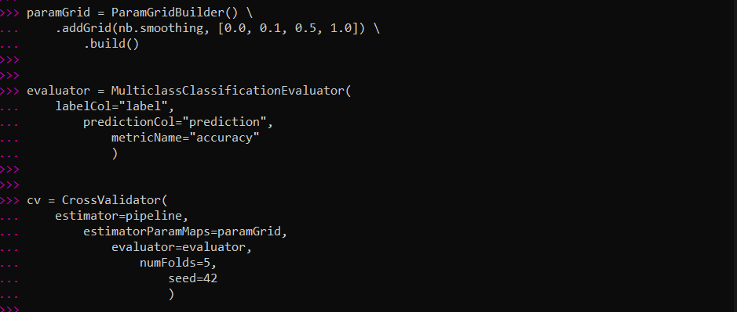
paramGrid = ParamGridBuilder() \
.addGrid(nb.smoothing, [0.0, 0.1, 0.5, 1.0]) \
.build()
cv = CrossValidator(
estimator=pipeline,
estimatorParamMaps=paramGrid,
evaluator=evaluator,
numFolds=5,
seed=42
)
evaluator = MulticlassClassificationEvaluator(
labelCol="label",
predictionCol="prediction",
metricName="accuracy"
)
4. Model Tuning:
○ Implemented CrossValidator with a ParamGrid for the smoothing parameter [0.0, 0.1, 0.5, 1.0].
○ Evaluated using accuracy metric.

Slide 10
accuracy = evaluator.evaluate(predictions)
print(f"Test Set Accuracy: {accuracy:.4f}")
confusion_matrix =
predictions.groupBy("label").pivot("prediction").count().fillna(0)
print("\n--- Confusion Matrix (Actual vs Predicted) ---")
confusion_matrix.show()
5 - Evaluation:
○ Computed accuracy on the test dataset.
○ Displayed a confusion matrix to visualize classification performance.

Slide 11
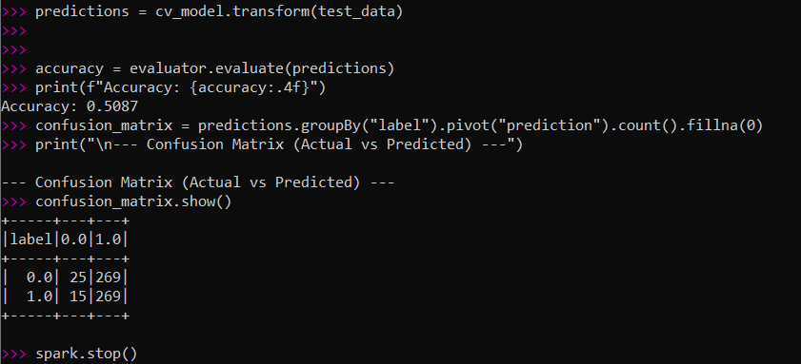
OUTPUT :

Slide 12
THANK YOU

